Slide 1
Talk 21 Triumph of Capital Part Two

Slide 2
Economic situation 1890’s
Increasing
Economic wealth of nation
Inequality
Working hours
Debts
Decreasing
Real wages …declining 2% per year (after 2 decades of increase)
Home ownership/living conditions…from single family to multi family homes
Public health ….crowded cities, sanitation, absence of safety (35,000 deaths per year)

Slide 3
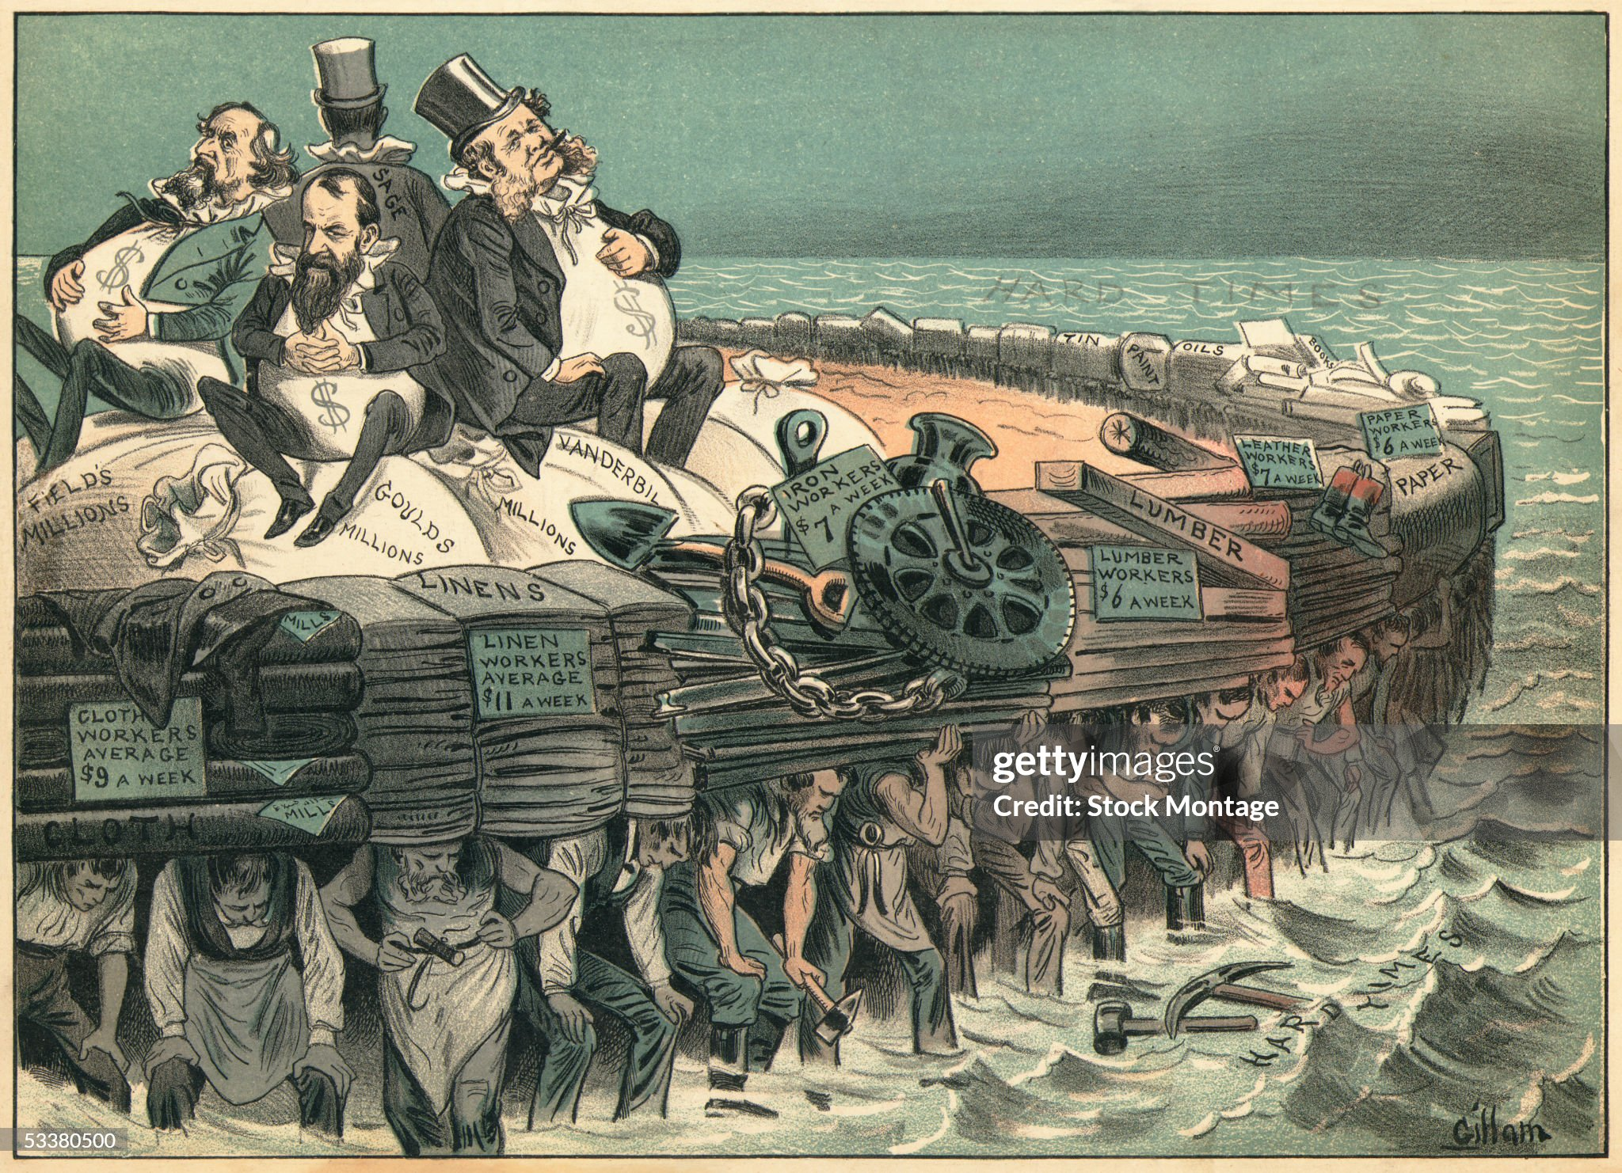
The Robber Barons: as seen from ‘below’

Slide 4
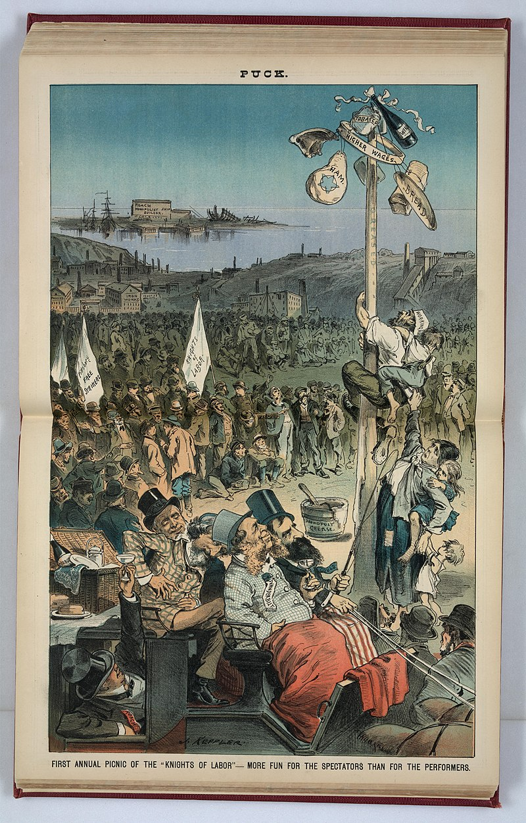
Knights of Labour
First US national union…formed
1866,,,”8 hour day” programme for gov workers…collapses in Panic of 1873
Noble and Holy Order of Knights
Founded 1869…secret society
,,,open to all skills
…diminish skilled vs unskilled wage gap
…8 hour day, end convict & child labour
…land Tax on all
…open to women, blacks but not Chinese
800,000 members 1885…wins rail strike
Tries to run political candidates….fails
Committed to non violence….but
…Seattle rail strike. Rock Springs Massacre 1885…’Knights’ kill 50 Chinese
...Thibidoux Massacre, New Orleans, 50
Black Knights shot dead by police strike breakers

Slide 5
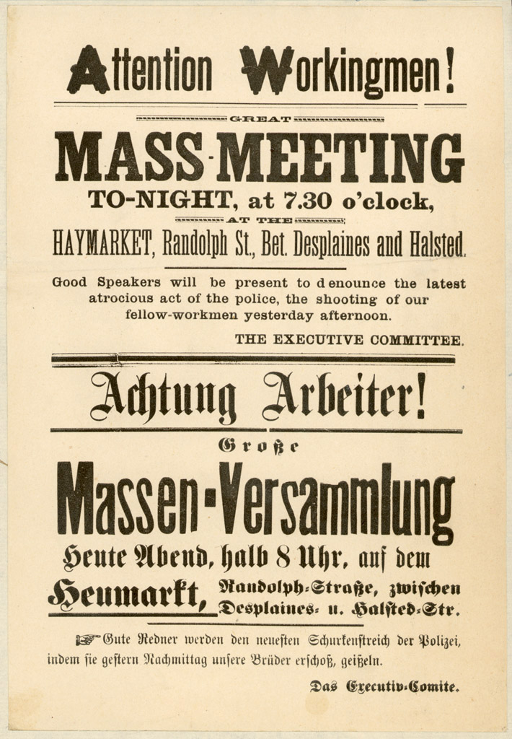
The Haymarket Riot 1887
Knights demand 8 hour day from Harvester Manufacturer Chicago
Protest meeting…led by anarchists
….bomb thrown at Police…gunfire, 7 police, 4 demonstrators killed
Police arrest “Haymarket 8” ..bomber
Never found…..Knights leader disowns
…members protest/ arrests random
…Judge rejects “left” jurists
….6 of 8 hanged..….strike abandoned
…public anti union
Knights of Labour Membership collapses..
….move to new unions AFL
...strikes leaderless and ineffectual

Slide 6
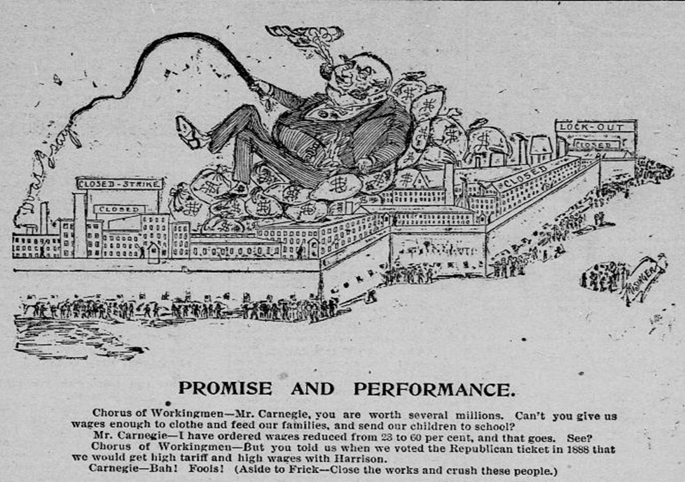
Homestead Strike 1892
Carnegie imposes new means of
working…runs 24 hours…expands
workforce replacing skilled with unskilled …wages cut
Amalgamated Association of Steel workers
Formed to resist….take over plant, defeat
strike breakers..deal made 1889…modest
Wage cuts….improved conditions
…worker run plant (800 out of 3,000)
.. Deal expires 1892..
Carnegie to Europe..hires Henry Frick to
manage operations…”do what it takes”
Prices rising, steel booming AAA seek
Pay rises…Frick demands 22% pay cut

Slide 7
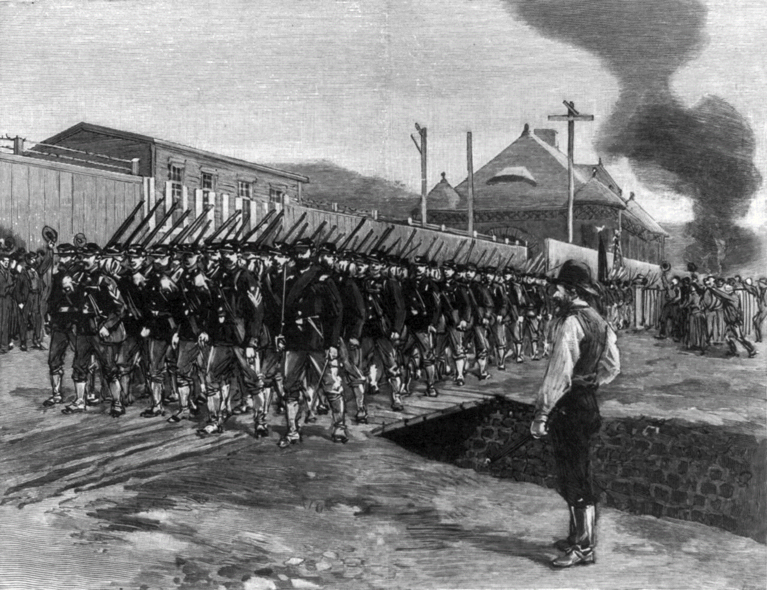
Homestead Strike (2)
AAA occupies plant
“lock out” management
Frick sends 300 Pinkerton
Agents…Winchesters
Gun battle, 7 Pinkertons
3 workers killed…Pinkertons
Surrender..Frick appeals
to Governor/ President Harrison
Army of 5,000 seizes plant
Negotiations…Frick wounded
….public support erodes
….Strike abandoned
…union made bankrupt by
Legal fees
…other major union does
Not intervene…AFL

Slide 8
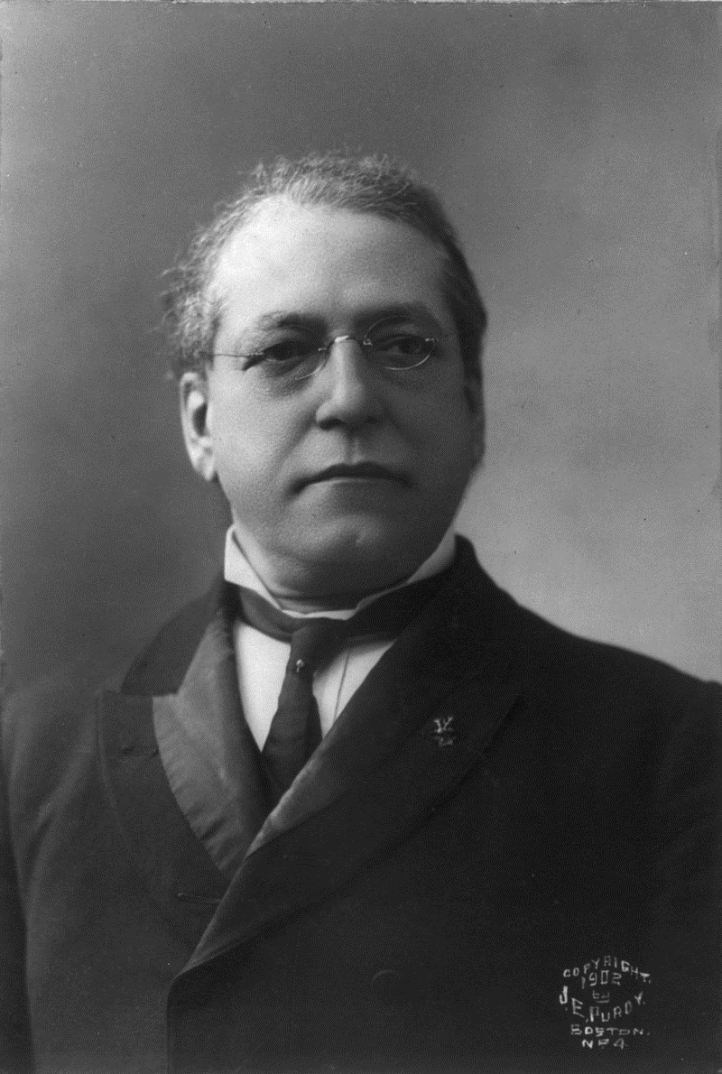
Samuel Gompers (1850-1924)
Born London Gumpertz….Jewish
Free school to US with family age 13
Cigar worker….joins union. Capable
organizer
Found American Federation
…focus only on wages, conditions
…anti immigration
…skilled labour only
Restricts activities to wages…
…lends support to politicians
…Democratic party…unions & anti immigration
…Republicans pro business & immigration

Slide 9
Socialism USA
Eugene Debs (1855-1926)
Does not emerge as political force
Till 1870s and rapid industrialisation
First unions in Railway ..Debs ..state
School…no college..needs job gets
Job as “de greaser” Engineer….fireman
…organises Union….”labour and capital
friends”
…temperance/hard work/honesty
Radicalised by Pullman Strike…
Imprisoned…reads Marx..founds
Social Democratic Party 1897
Seeks non violent revolution with
Workers/unions gaining power by
Elections and common ownership

Slide 10
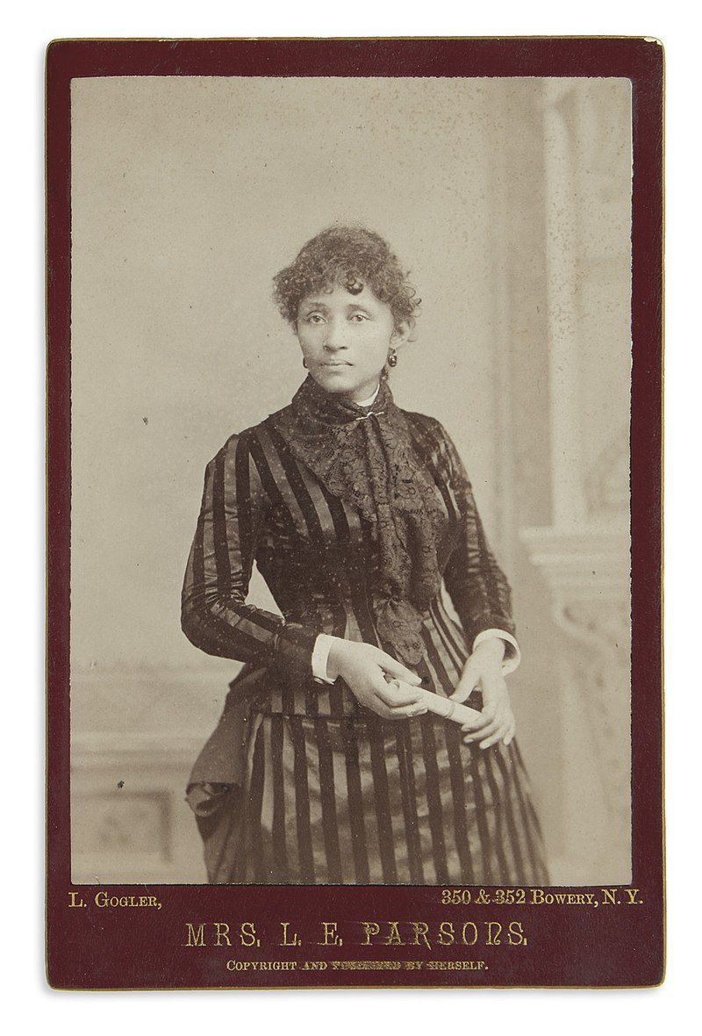
Anarchism in USA
“Anarchism”….natural fit with
American ideal of individualism
Lucy Parsons (1850-1942)
Early 19th century….withdrawal
From society…Henry Thoreau
“Walden Pond”
Reaction to industrialisation and Communist thought…..leadership roles early Unions ..many writers..Esp German immigrants
Lucy Parson & husband Albert…social
Anarchists…condone violence when needed
Attend Haymarket Riot.. Albert hanged (!)
Lucy full time speaker, writer. Workers
Rights, justified violence, woman's rights
Tours across USA & UK..denies bombing

Slide 11
Unrest in the farmlands
Farmers movement originating in “Grange” of 1870’s
Agricultural unrest 1880’s ….Farmers Alliances spread West and South
Falling prices of food as supply increases from Tsarist Russia/ Canada
Power of railroad monopolies and price fixing
Increased debt to mechanise….want inflation to reduce debt….SILVER
Return of dry weather
Populist Party formed in 1892:
Monetise silver
Break up monopolies

Slide 12
Election of 1888
Democrats….”Good old Grover”
Small Government….. Do nothing, let market decide
Low tariff…support farmers
White supremacy, immigration restrictions
Gold Standard
Republicans: Civil War hero, grandson of President Benjamin Harrison
Support business
High tariff
Inflate currency by issuing silver
Commits to “reform”

Slide 13
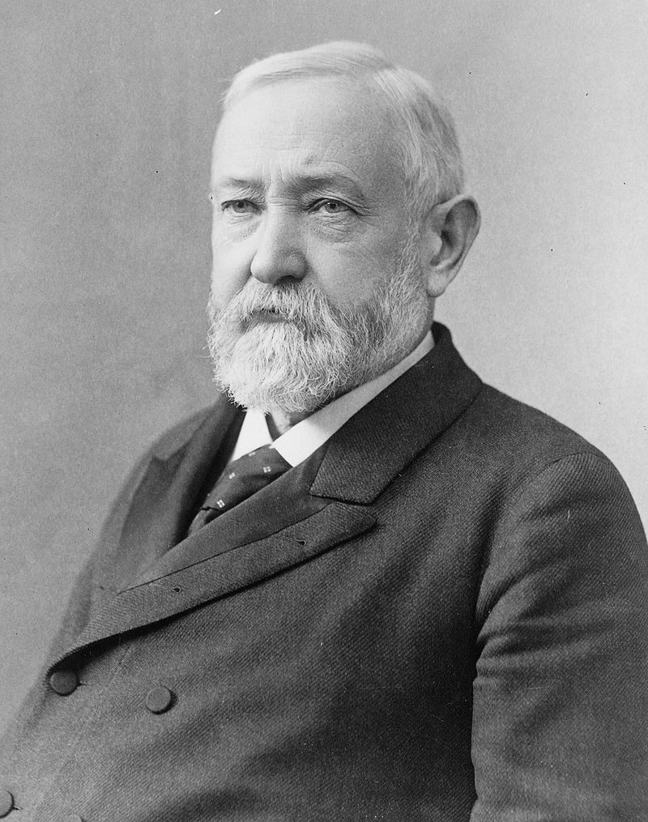
Benjamin Harrison (1833-1901)
Grandson of President William Harrison …civil war hero
Expands Civil Service Reform….50% Jobs merit
Attempt to increase voting by blacks in South
…. abandons due to opposition in Senate
Doubles silver convertibility to increase money
Supply….win over new Populist voters
Passes first “Anti Trust Act”….test for reasonableness and “public interest”
…no enforcement mechanism….toothless
Introduces idea next step USA overseas Empire
….funds expansion of Navy
…annexes Kingdom of Hawaii
Populists unimpressed…want more silver
& split Republican Vote at 1892 election
……..“Good old Grover” re-elected

Slide 14
Triumph of Capital 1892-1896

Slide 15
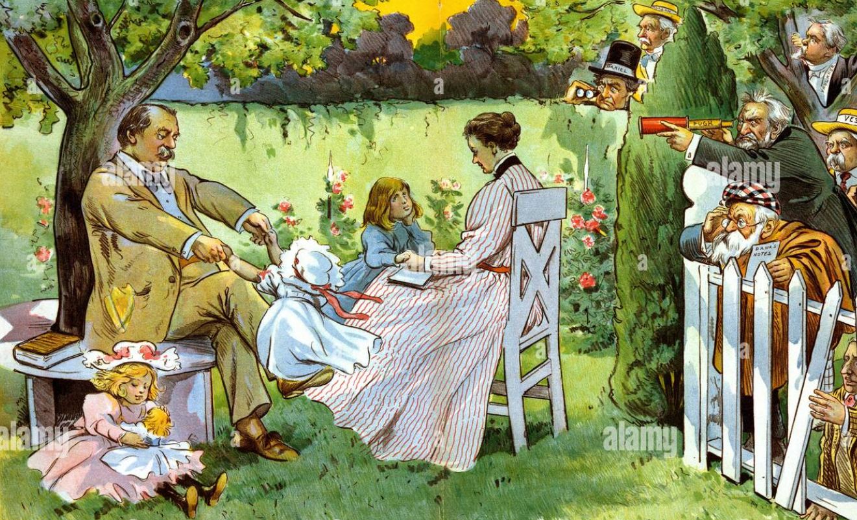
Cleveland’s second term….what he expects

Slide 16
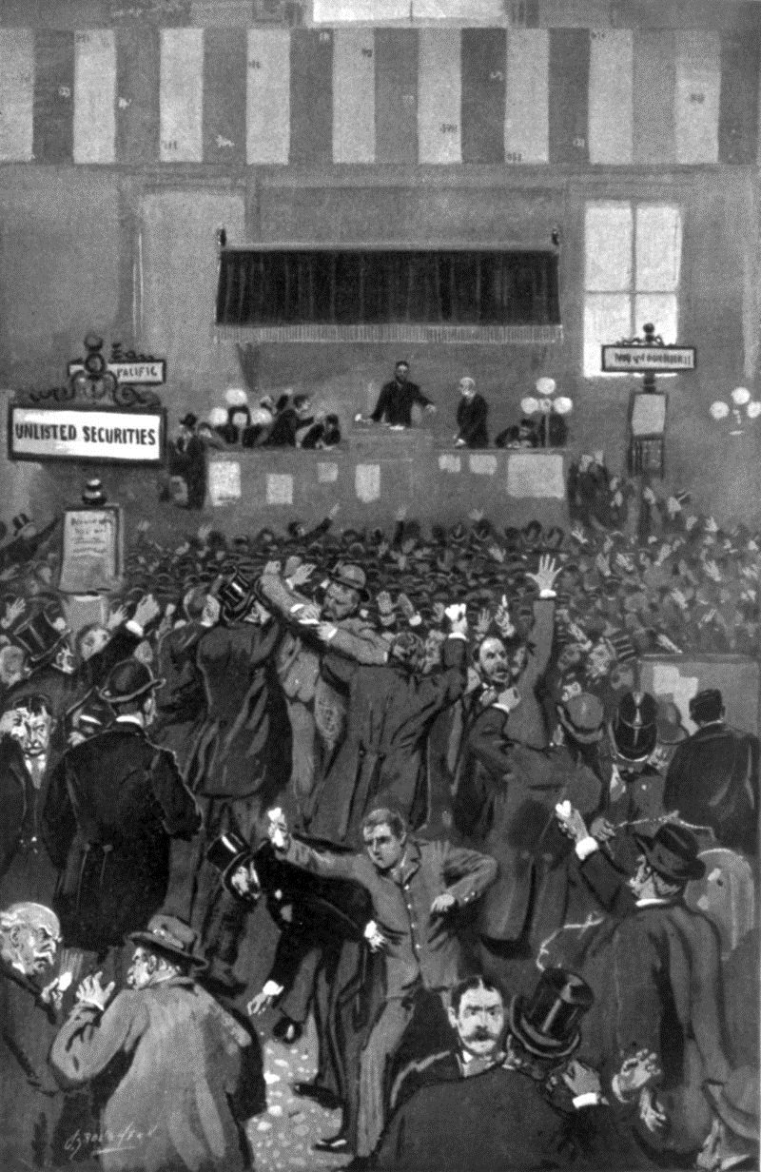
The Panic of 1893
Winter 1892…Argentina defaults on debt….rising demand for Gold
Gold leaving USA due to silver purchase (Gresham’s Law) Gold Reserves 1891--- $190 million fall to less than $100 million
Rush for gold and reclaiming of debt…US assumed out of control…..
February 1892..first railroads go bankrupt
Stock Market falls 50%
Unemployment rises from 5% to 18%
500 banks fail…millions lose savings
15,000 companies fail

Slide 17
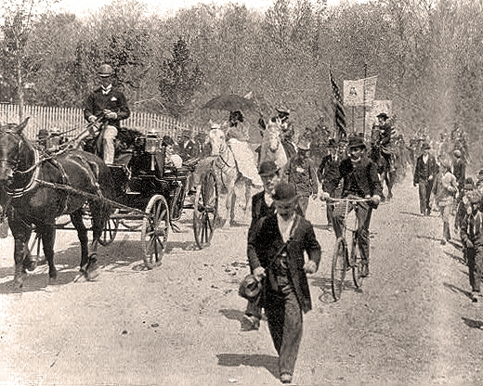
Coxey’s Army
Starvation breaks out in industrial areas
Series of marches on Washington from West and Midwest…Official name: Army of the Commonwealth in Christ
…first ever protest for welfare/support
….payment in paper Currency
….public works
500 marchers in Montana seize train and run it
To Midwest ..but intercepted before
Reaching Washington
Coxey and leaders arrive ahead of
6,000 marches from Pennsylvania
For walking on grass.

Slide 18
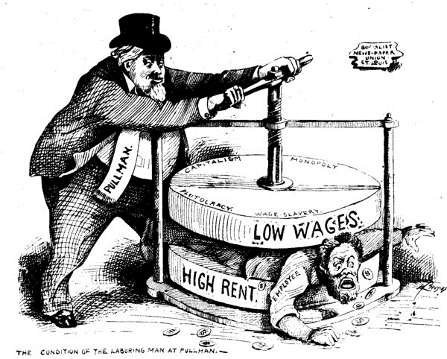
Pullman Strike 1894
Eugene Debs leads
Railway union…Pullman “rail car maker”Owns town, stores, housing
Company demands 28%
Pay cut …without reducing
Housing costs
Debs organises “lock down”
Pullman hires blacks from
South. Others…
Strike spread across
Railroads…130,000 workers
Pullmans request help from Cleveland
…..Army of 12,000 arrives

Slide 19
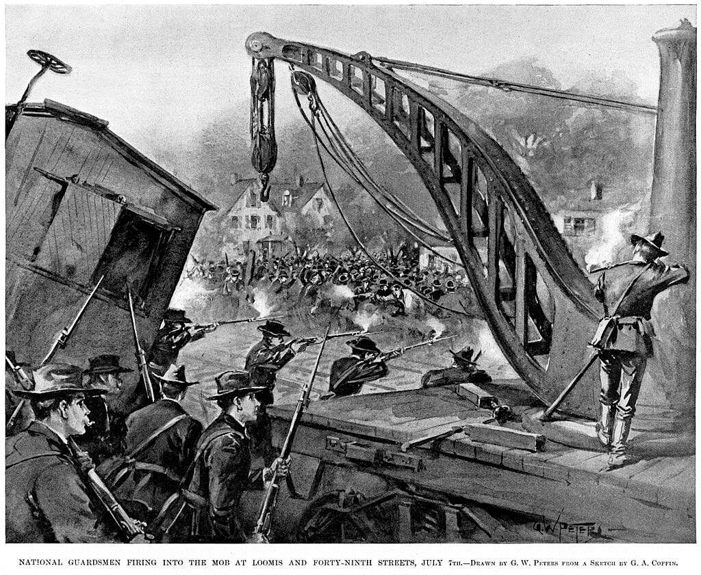
Gun battle US Army and strikers ….trains derailed. Gun battle breaks out …35 killed…..strike broken..Debs arrested

Slide 20
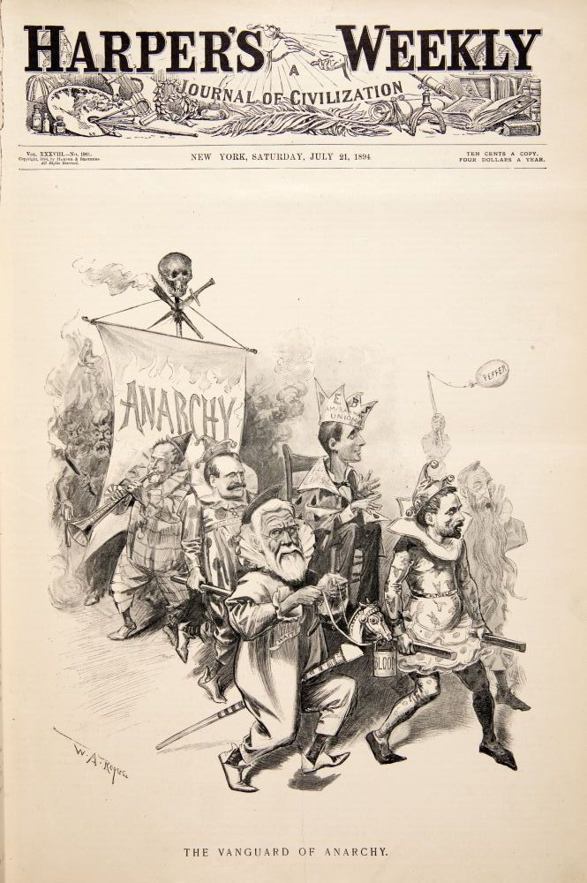
Public reaction…mostly anti union
Gompers and AFL
Withhold support
Media campaign
Demonises Union
As communist &
anarchists
Unions split:
….radical….political
…moderate. Improve Wages & conditions
Debs forms Socialist
Part of USA 1897..commit
To non violence
Violence…theme of
20th century

Slide 21
Cleveland response to Panic
Politic belief “It is the responsibility of the citizens to support the government, not the responsibility of the government to support the citizen.”
Refuses to intervene or supply relief
Intervention outside Government remit
Relief Responsibility of charities
Commited to protecting currency revokes use of silver…return to Gold Standard
Gold reserves decline to less than £100 million…risk US will default on debt …become a new Argentina?
Reaches out J.P Morgan and Rothschild bank to support US currency

Slide 22
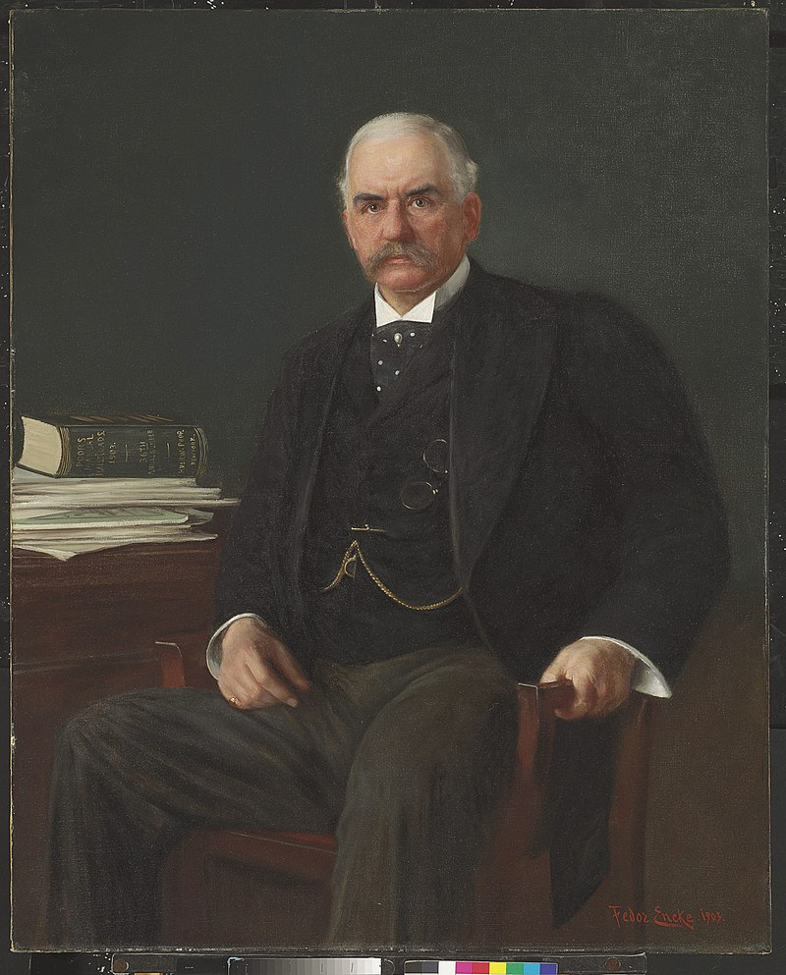
J P Morgan (1837-1913)
Son of wealthy merchant And partner of Peabodies Bank in London. J Pierrepoint” …Educated Germany
Works with father in London…speculates bonds during Civil War…arms purchases
Devout…committed to long term value
Motto: “remember that there is an Eye above that is ever upon you and that for every act, word, and deed you will one day be called to give account."[1
Pioneer in equity financing, bank consolidation
Demands meeting with Cleveland during Panic
…creates syndicates with Rothschild to finance
Return of Gold to US $50m….
Confidence restored…bank failures cease
…economy recovers slowly by 1897
…US economic policy outsourced to bank

Slide 23
Election of 1896
Republicans:
Harrison discredited….
Part united behind ‘Sound Money’, high tariffs, immigration, and Empire
Nominate William McKinley…last civil war veteran, Governor of Ohio
Democrats split
Cleveland discredited and rejected: “Bourbon Democrats”
Rising Populist Party powerful threat
Democratic Convention…intense debate…no obvious candidate

Slide 24
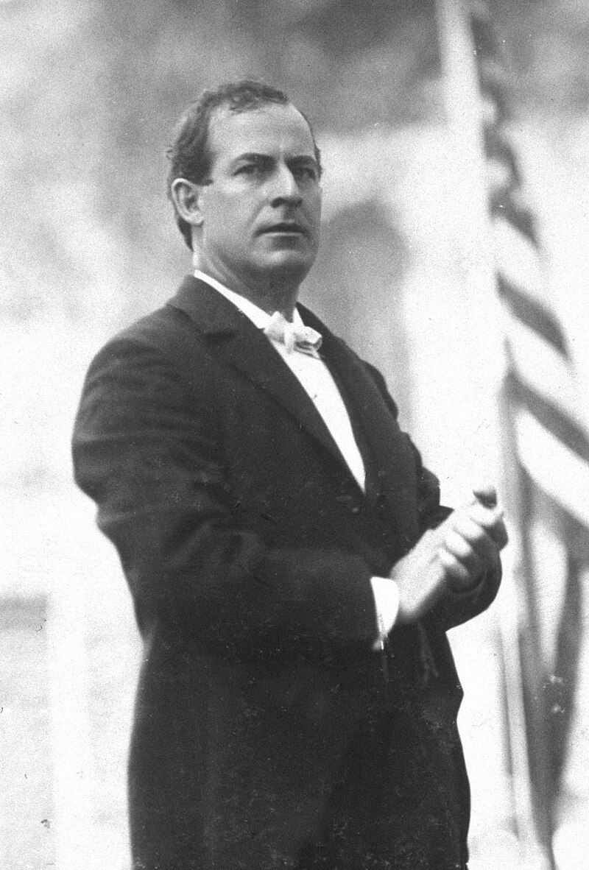
William Jennings Bryan (1860-1925)
Born Nebraska, lawyer
Devout evangelist
Congressman 1890
Powerful speeches
For lower tariffs, ….Monetisation Of silver
….Breaking up trusts
….Progressive income tax
…new age of common man
Invited to speak at
Democratic Convention

Slide 25
Cross of Gold Speech
If they dare to come out in the open field and defend the gold standard as a good thing, we shall fight them to the uttermost, having behind us the producing masses of the nation and the world.
Having behind us the commercial interests and the laboring interests and all the toiling masses, we shall answer their demands for a gold standard by saying to them, you shall not press down upon the brow of labor this crown of thorns.
You shall not crucify mankind upon a cross of gold.
Speech secures
Bryan nomination

